Slide 1
Plan for 3D Deep
Jungwon Kang, Maryam Jameela, Razieh Ramak
Sept 30 2018

Slide 2
Objectives
Building 1st Version Deep Network for Each Task
Task | Major Contributor | Objectives
Noise filtering (for Optech) | Razieh Ramak | Point cloud segmentation (Noise/Non-noise), non real-time
Point cloud segmentation (for Optech) | Maryam Jameela | Point cloud segmentation (N-class objects), non real-time
3D object detection (for Thales) | Jungwon Kang | Real-time 3D object detection

Slide 3
Schedule
Month | Task | Deliverable
Oct 2018 | • Problem definition • Dataset preparation • Literature survey | • Document describing problem definition, dataset, and literature survey • Visualization of dataset
Nov | • Practicing deep library • Design & implementation | • Document describing design
Dec | • Implementation | • Source code (Dec 31)
Jan 2019 | • Documentation | • Document describing implementation (Jan 15)
*Submission deadline of major conferences starts from March.

Slide 4
Management Policy
Regular meeting or discussion biweekly
Team website:
https://github.com/yorku-ausml/deep3d

Slide 5
To-do List
Written on Oct 1 2018
Problem definition, including
Cause of noise (Razieh)
Object classes (Maryam, Jungwon)
Dataset description, including
Existing Optech airborne dataset (Razieh)
Dataset size
Current repository
Visualization
Etc
Finding point cloud label tool (for making ground-truth)
Finding visualization tool

Slide 6
Key Literature
Written on Oct 1 2018
Point cloud segmentation
Large-scale point cloud segmentation with superpoint graphs https://github.com/loicland/superpoint_graph *Rank 1 in http://www.semantic3d.net/
PointNet++: deep hierarchical feature learning on point sets in a metric space https://github.com/charlesq34/pointnet2 *Rank 4 in http://www.semantic3d.net/
Object detection
Joint 3D proposal generation and object detection from view aggregation https://github.com/kujason/avod
*Literature list is also available at https://github.com/yorku-ausml/deep3d/wiki/Related-works

Slide 7
Current Progress
Oct 12 2018

Slide 8
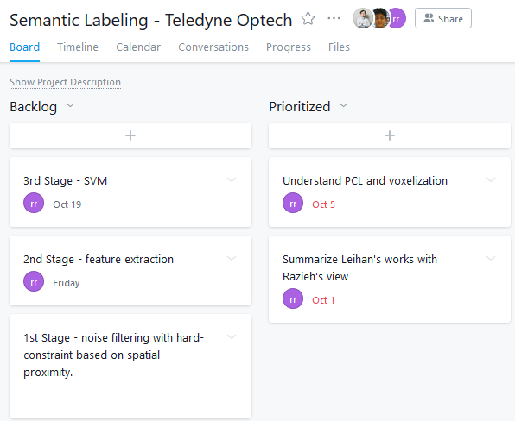
Asana Assignment

Slide 9
Progress on Noise Filtering
Razieh
Atmospheric noise filtering
Noise filtering Segmentation of raw point cloud using voxelization Pre-classification by defining special rules
Feature extraction Using Eigen library and programming
Classification sing SVM Using “libSVM”
Understanding PCL and voxelization
PCL A large scale, open project for 2D/3D image and point cloud processing. However, there is no PCL in noise filtering application
Voxelization A data structure used to represent a collection of multi-dimensional points and is commonly used to represent three-dimensional data

Slide 10
Clarifying the Task
Dataset used for training?
What kind of dataset will be used? Mobile data / airborne lasers / hybrid dataset mixture of both.
What kind of environment? Indoor / Outdoor or Urban / Rural / Forest
Which object classes?

Slide 11
Key Papers
Point cloud segmentation
PointNet: Deep Learning on Point Sets for 3D Classification and Segmentation https://github.com/charlesq34/pointnet *Both used in the two following papers
PointNet++: deep hierarchical feature learning on point sets in a metric space https://github.com/charlesq34/pointnet2 *Rank 4 in http://www.semantic3d.net/
Large-scale point cloud segmentation with superpoint graphs https://github.com/loicland/superpoint_graph *Rank 1 in http://www.semantic3d.net/

Slide 12
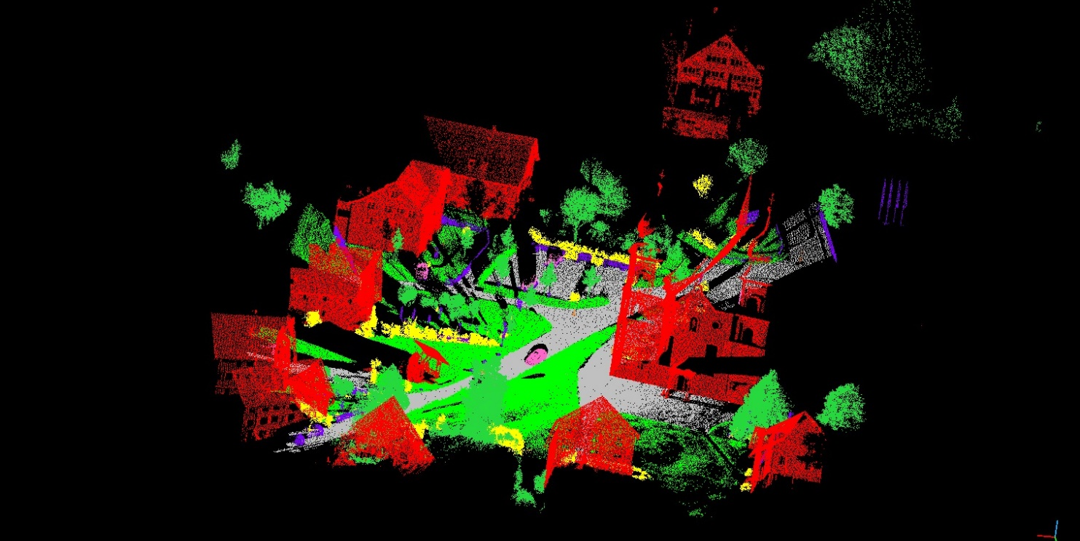
Publicly Available Dataset ^{(1/3)}
Semantic3D
LiDAR dataset with over 3 billion points from a variety of urban and rural scenes.
http://www.semantic3d.net/
Managed by ETH (http://www.prs.igp.ethz.ch/)
8 class labels, namely {1: man-made terrain, 2: natural terrain, 3: high vegetation, 4: low vegetation, 5: buildings, 6: hard scape, 7: scanning artefacts, 8: cars}.

Slide 13
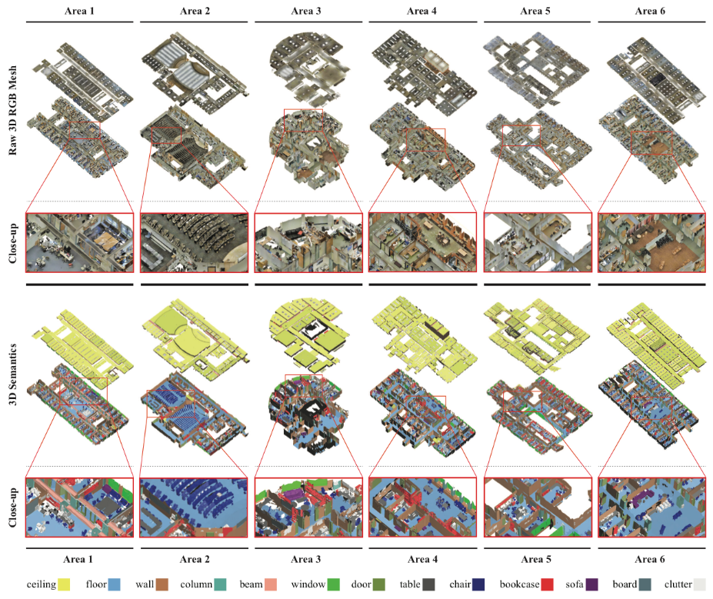
Publicly Available Dataset ^{(2/3)}
S3DIS (Stanford Large-Scale 3D Indoor Space)
3D RGB point clouds of six floors from three different buildings
http://buildingparser.stanford.edu/dataset.html
Currently, 2D-3D-S dataset is newly released.
13 object classes (ceiling, floor, wall, beam, column, window, door, and movable elements: table, chair, sofa, bookcase, board and clutter for all other elements)

Slide 14
Publicly Available Dataset ^{(3/3)}
Etc
Oakland 3-D Point Cloud Dataset (2009)
http://www.cs.cmu.edu/~vmr/datasets/oakland_3d/cvpr09/doc/
NYU Depth Dataset V2 (2012)
https://cs.nyu.edu/~silberman/datasets/nyu_depth_v2.html
Sydney Urban Objects data set
http://www.acfr.usyd.edu.au/papers/SydneyUrbanObjectsDataset.shtml
IQmulus & TerraMobilita Contest
Mobile laser scans (MLS) in dense urban environments
http://data.ign.fr/benchmarks/UrbanAnalysis/
Vaihingen3D airborne benchmark
http://www2.isprs.org/commissions/comm3/wg4/3d-semantic-labeling.html

Slide 15
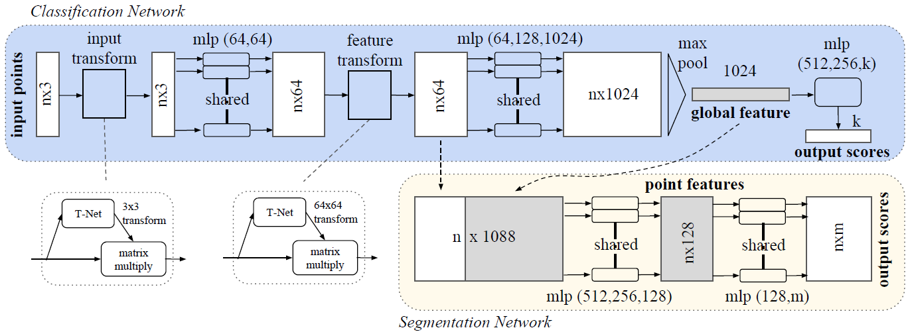
PointNet
Architecture
http://stanford.edu/~rqi/pointnet/
CVPR 2017

Slide 16
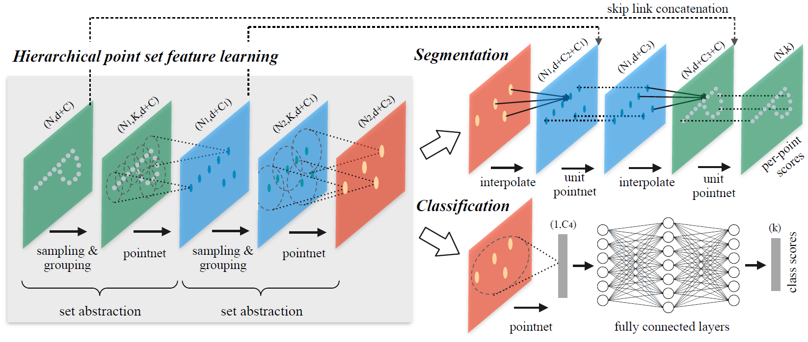
PointNet++
Hierarchical Feature Learning Architecture
http://stanford.edu/~rqi/pointnet2/
NIPS 2017

Slide 17
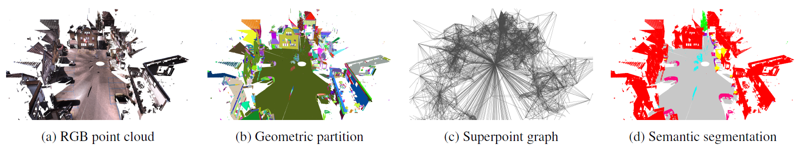
Superpoint Graph ^{(1/2)}
Individual steps in pipeline
CVPR 2018

Slide 18
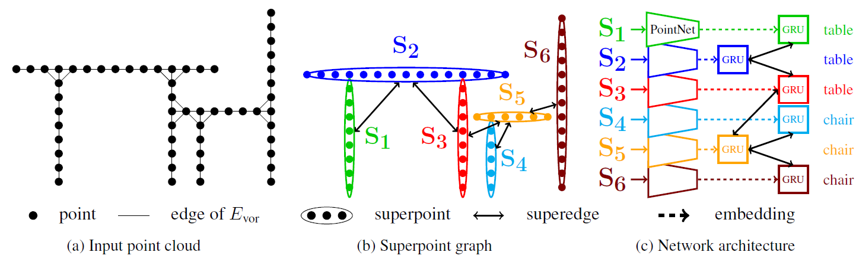
Superpoint Graph ^{(2/2)}
CVPR 2018

Slide 19
Plan
Month | Task | Deliverable
Oct 2018 | • Problem definition • Dataset preparation • Literature survey | • Document describing problem definition, dataset, and literature survey • Visualization of dataset
Nov | • Practicing deep library • Design & implementation | • Document describing design
Dec | • Implementation | • Source code (Dec 31)
Jan 2019 | • Documentation | • Document describing implementation (Jan 15)

Slide 20
Current Progress
Oct 19 2018

Slide 21
Asana Assignment

Slide 22
Notes
Summarizing why noise happens, including some figures describing laser pulse and error band, and the terms like PIA and correspondence
Knowing limitations of PointNet and how PointNet++ solve it
Checking some parts (in Superpoint graph method) that the hand-crafted things are needed. (e.g. superpoint creation, superedge features)
Knowing limitations of superpoint graph method
Understanding how each method deal with object-scale issue and contextual information
Shenlong Wang's paper
Deep Parametric Continuous Convolutional Neural Networks

Slide 23
Noise filtering ^{(1/2)}
LiDAR is a relatively new technology which is an alternative to field surveying and photogrammetric techniques to collect elevation data. This technology is able to provide high accuracy three-dimensional data with reasonable cost and time. 3-D data acquired by this technology are applicable in 3-D urban modeling, DTM generation, mapping and etc. Although LiDAR data present high height accuracy, there are some defects in them leading to some disadvantages in output of next processes. Hence, these errors should be removed before performing any process. One of the most important errors in LiDAR data is the outlier points. Measured elevation for these points is unreasonably more or less from their neighboring points. The outliers are mainly measurements that do not obey the local surface geometry and do not belong to the topography of the interested area. In some references in the literature, the points with too high elevation values are named "positive outliers" and the points with too low elevation values are named "negative outliers", so we used these terms, too. The outliers can be caused from different sources. Positive outliers are resulted from hitting laser beams to suspended objects at high altitude like atmospheric articles. In connection with the negative outliers, it is believed that the laser beams be reflected several times among the glasses of buildings before they are detected, just like the multi-path effect of GPS. These specular reflections result in a longer travel time of the laser beam, and thus a lower elevation is calculated during post-flight processing. The negative outliers are often located at a few spots beside which there are tall buildings

Slide 24
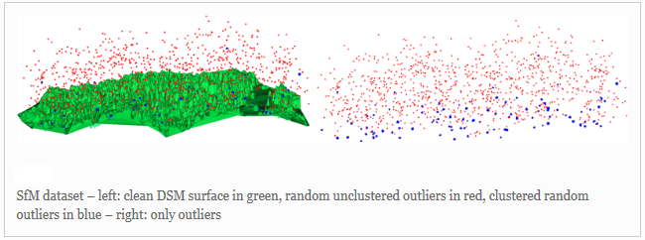
Noise filtering ^{(2/2)}
Outliers in LiDAR data

Slide 25
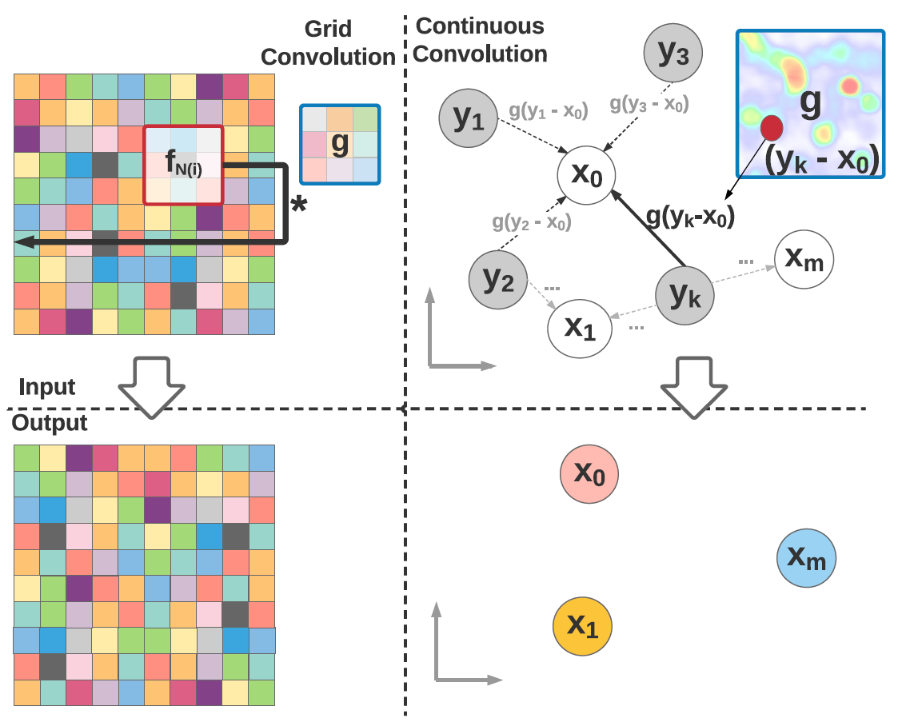
Deep Parametric Continuous CNNs ^{(1/5)}
Unlike grid convolution, parametric continuous convolution uses kernel functions that are defined for arbitrary points in the continuous support domain.
As a result, it is possible to output features at points not seen in the input.

Slide 26
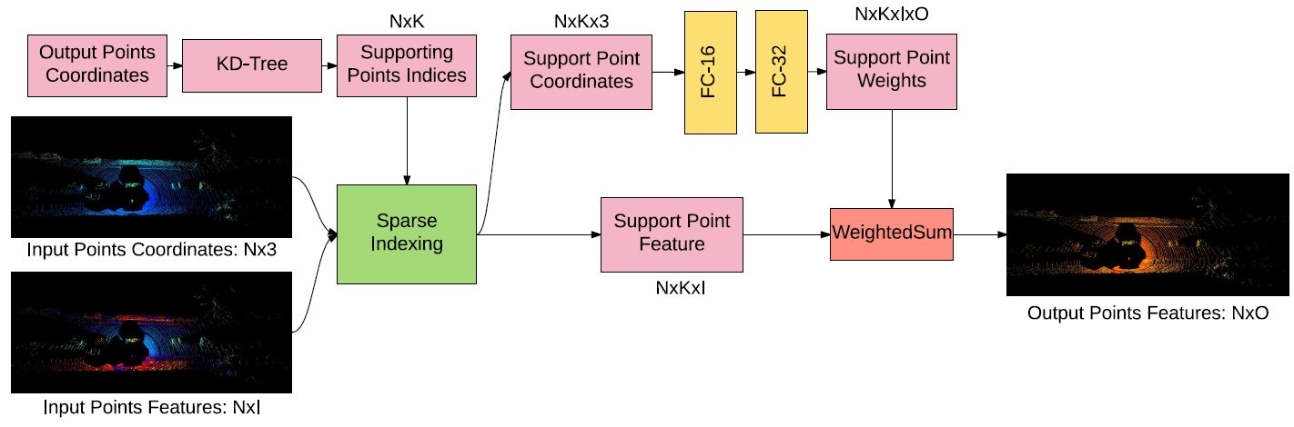
Deep Parametric Continuous CNNs ^{(2/5)}
Detailed Computation Block for the Parametric Continuous Convolution Layer

Slide 27
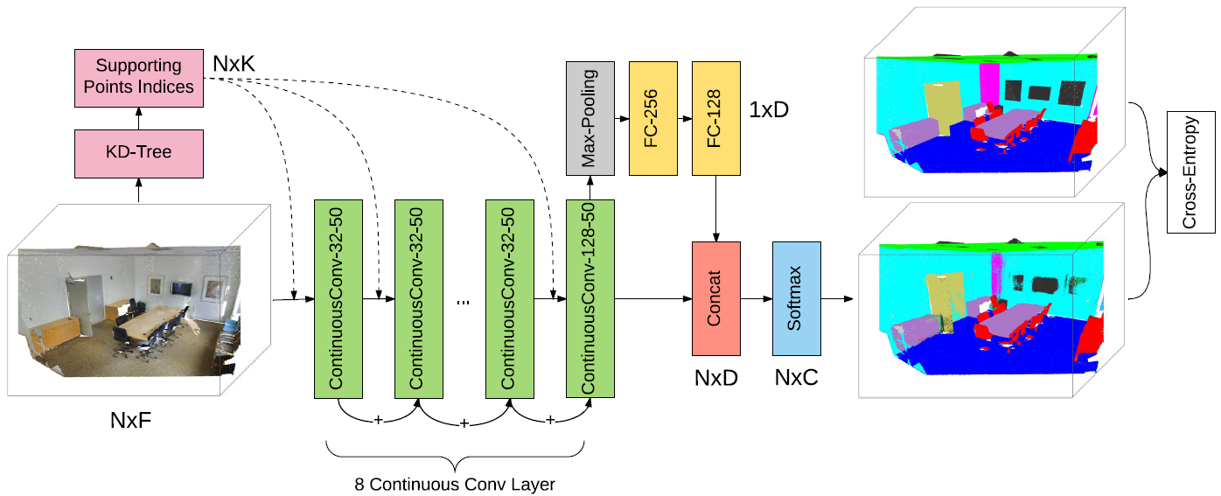
Deep Parametric Continuous CNNs ^{(3/5)}
Architecture of the Deep Parametric Continuous CNNs for Semantic Labeling Task

Slide 28
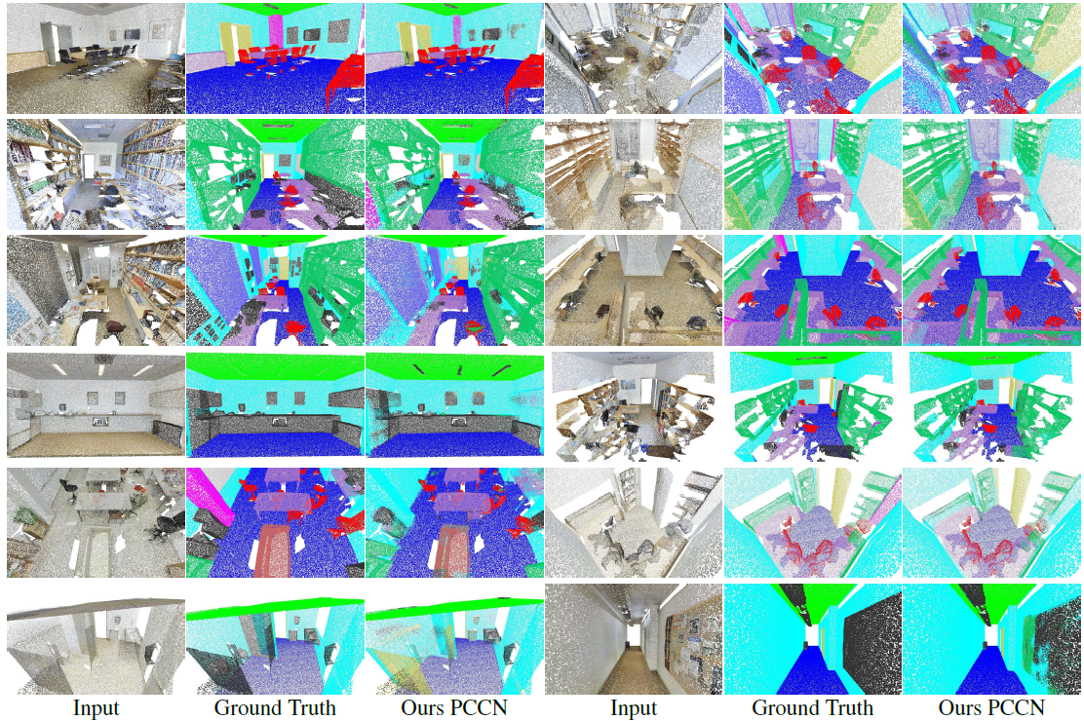
Deep Parametric Continuous CNNs ^{(4/5)}
Semantic Segmentation Results on Stanford Indoor3D Dataset

Slide 29
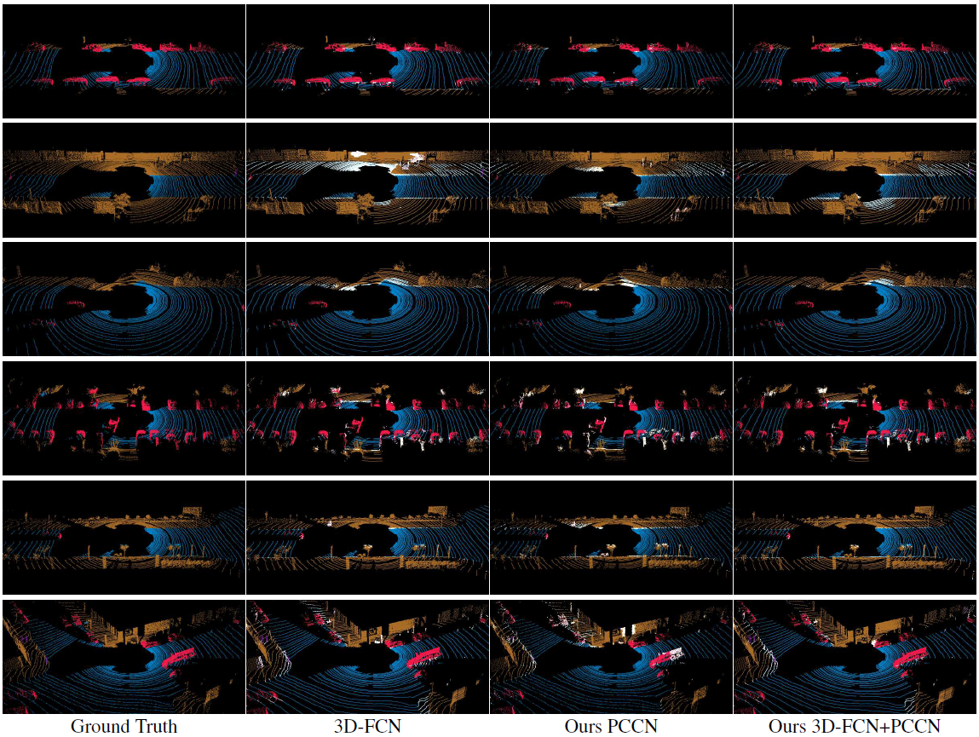
Deep Parametric Continuous CNNs ^{(5/5)}
Semantic Segmentation Results on Driving Scene Dataset; Colored: correct prediciton; white: wrong prediciton.

Slide 30
Plan
Month | Task | Deliverable
Oct 2018 | • Problem definition • Dataset preparation • Literature survey | • Document describing problem definition, dataset, and literature survey • Visualization of dataset
Nov | • Practicing deep library • Design & implementation | • Document describing design
Dec | • Implementation | • Source code (Dec 31)
Jan 2019 | • Documentation | • Document describing implementation (Jan 15)

Slide 31
Current Progress
Nov 5 2018

Slide 32
Objectives
Building 1st ver deep network for each task
Task | Major Contributor | Objectives
Noise filtering | Razieh Ramak | Point cloud segmentation (Noise/Non-noise), non real-time
Point cloud segmentation | Maryam Jameela | Point cloud segmentation (N-class objects), non real-time
3D object detection | Jungwon Kang | Real-time 3D object detection

Slide 33
Plan
Month | Task | Deliverable
Oct 2018 | • Problem definition • Dataset preparation • Literature survey | • Document describing problem definition, dataset, and literature survey • Visualization of dataset
Nov | • Practicing deep library • Design & implementation | • Document describing design
Dec | • Implementation | • Source code (Dec 31)
Jan 2019 | • Documentation | • Document describing implementation (Jan 15)
*Submission deadline of major conferences starts from March.

Slide 34
Paper List
Papers we have read (for point cloud segmentation)
Title | Conference
PointNet: deep learning on point sets for 3D classification and segmentation | CVPR 2017
PointNet++: deep hierarchical feature learning on point sets in a metric space | NIPS 2017
Large-scale point cloud segmentation with superpoint graphs | CVPR 2018
Deep parametric continuous convolutional neural networks | CVPR 2018
SPLATNet: sparse lattice networks for point cloud processing | CVPR 2018

Slide 35
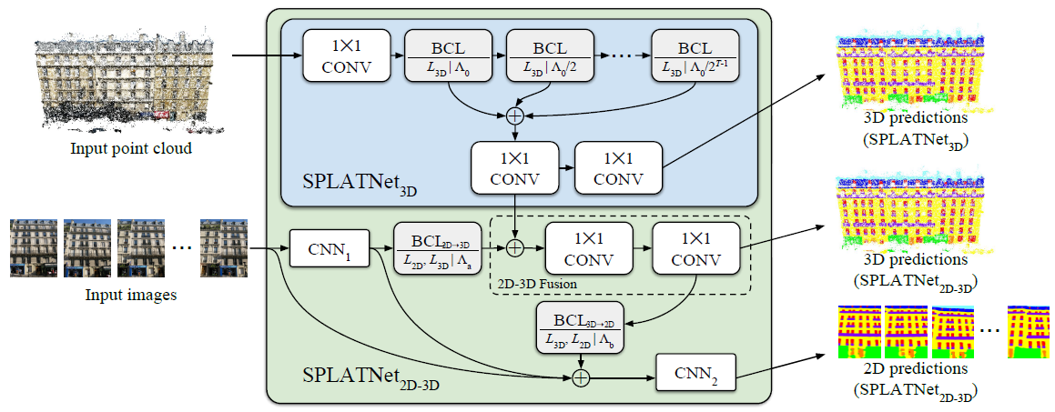
SPLATNet:Sparse Lattice Networks ^{(1/2)}
SPLATNet
Illustration of inputs, outputs and network architectures for SPLATNet_{3D} and SPLATNet_{2D-3D}.

Slide 36
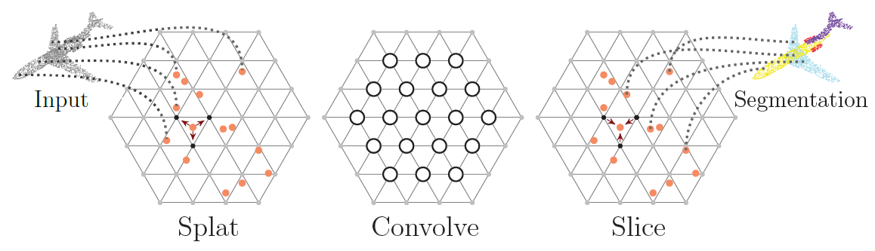
SPLATNet:Sparse Lattice Networks ^{(2/2)}
Bilateral Convolution Layer
Splat: BCL first interpolates input features F onto a d_{l}-dimensional permutohedral lattice defined by the lattice features L at input points.
Convolve: BCL then does d_{l}-dimensional convolution over this sparsely populated lattice.
Slice: The filtered signal is then interpolated back onto the input signal. For illustration, input and output are shown as point cloud and the corresponding segmentation labels.

Slide 37
What to do (during Nov)
Continuing literature survey
Thinking of what the fundamental issues are unresolved
Writing document about the literatures
Practicing deep library
Initial design of our own network

Slide 38
Current Progress
Nov 15 2018

Slide 39
Contents
Razieh's Progress on Noise Filtering
Paper Review
Future Plan

Slide 40
Paper Review

Slide 41
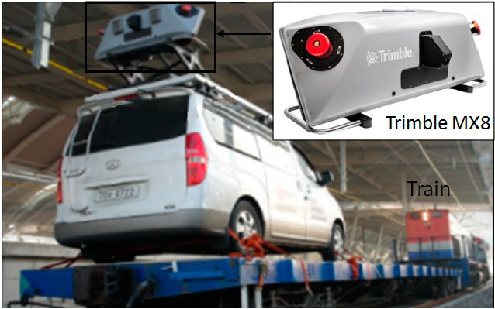
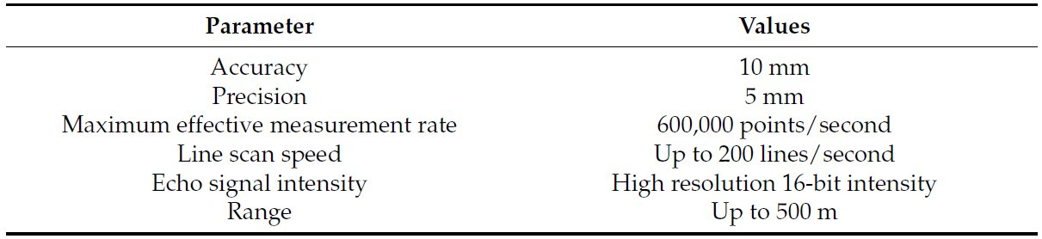
Multi-Range CRF ^{(1/5)}
Paper Review
Multi-Range CRF for Classifying Railway Electrification System Objects Using Mobile Laser Scanning Data, J. Jung, et al., Remote Sensing 2016
Trimble MX8 mounted on a train

Slide 42
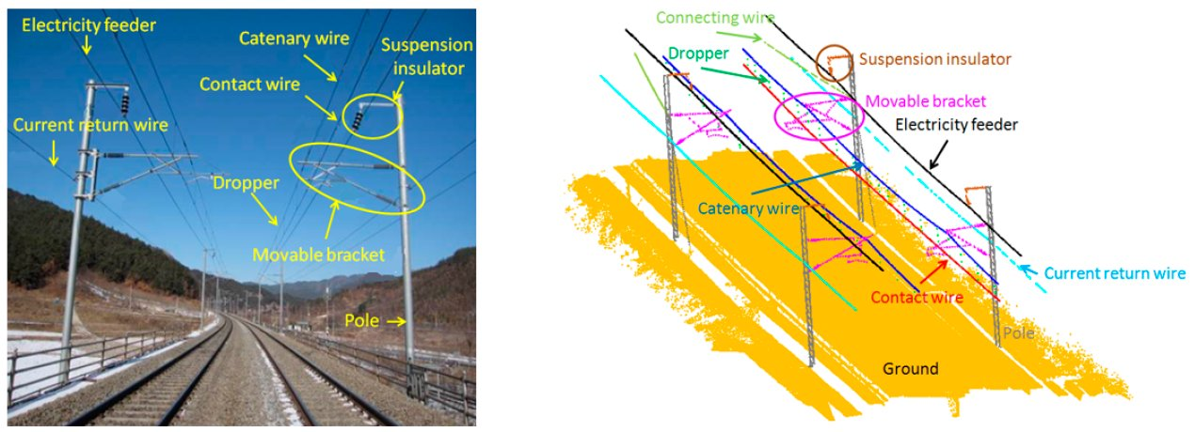
Multi-Range CRF ^{(2/5)}
Paper Review
Electrification system configuration and 10 object classes of the railway
a photograph (left), and Mobile Laser Scanning (MLS) data (right)

Slide 43
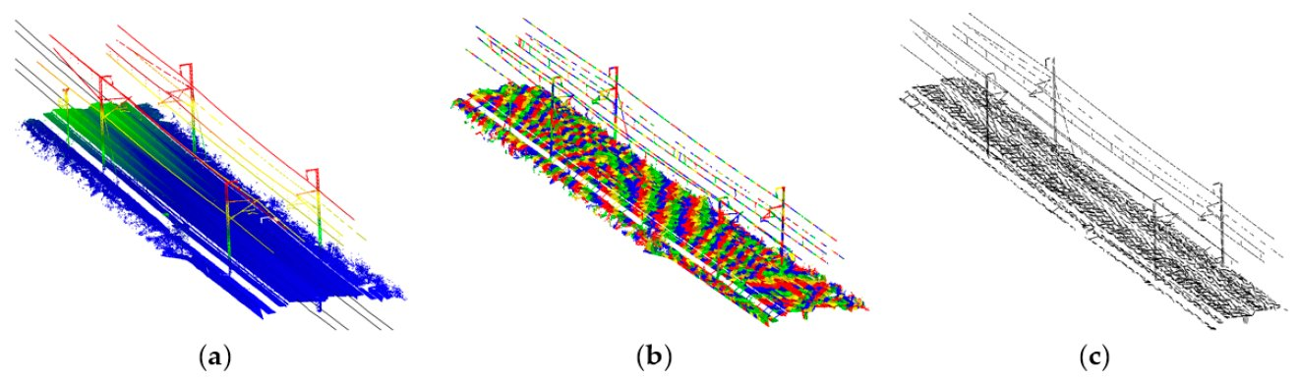
Multi-Range CRF ^{(3/5)}
Paper Review
Example of voxelization and line extraction:
(a) input MLS data and rail vectors, (b) voxelization, and (c) extracted lines

Slide 44
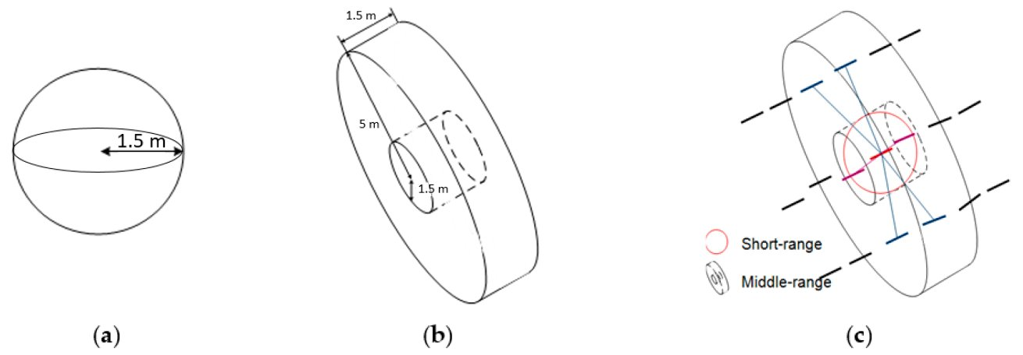
Multi-Range CRF ^{(4/5)}
Paper Review
Neighboring systems: (a) for short-range graph, (b) for long-range graph, and (c) combined neighboring systems

Slide 45
Multi-Range CRF ^{(5/5)}
Paper Review
Summary
Handled line segments rather than raw point clouds
(Short & Long) Multi-range CRF (which is a graphical model)
The 'Superpoint Graph' paper has a similar algorithm structure.

Slide 46
Future Plan

Slide 47
Practicing Deep Library
Producing initial results, while practicing deep library
Within this year (about 40 days remained)
Task 1: point segmentation (for Optech) on Semantic3D dataset
ex: PointNet
Task 2: object or lane detection (for Thales-AVIN)
Risk: only one available workstation

Slide 48
Further Reading ^{(1/2)}
Derek Hoiem
http://dhoiem.cs.illinois.edu/
Hoiem's papers (sequential segmentation-related)
3D-PRNN: Generating Shape Primitives with Recurrent Neural Networks, ICCV 2017
Learning to Localize Little Landmarks, CVPR 2016

Slide 49
Further Reading ^{(2/2)}
sequential segmentation-related
ReSeg: A Recurrent Neural Network-based Model for Semantic Segmentation
https://arxiv.org/pdf/1511.07053.pdf
Recurrent Segmentation for Variable Computational Budgets
https://arxiv.org/pdf/1711.10151.pdf
Combined convolutional and recurrent neural networks for hierarchical classification of images
https://arxiv.org/pdf/1809.09574.pdf
CNN-RNN: A Unified Framework for Multi-label Image Classification
https://arxiv.org/ftp/arxiv/papers/1604/1604.04573.pdf

Slide 50
Current Progress
Nov 28 2018

Slide 51
Contents
Razieh's Progress on Noise Filtering
Paper Review
Future Plan

Slide 52
Paper Review
ReSeg: A Recurrent Neural Network-based Model for Semantic Segmentation
https://arxiv.org/pdf/1511.07053.pdf
3D Recurrent Neural Networks with Context Fusion for Point Cloud Semantic Segmentation
http://openaccess.thecvf.com/content_ECCV_2018/papers/Xiaoqing_Ye_3D_Recurrent_Neural_ECCV_2018_paper.pdf
sequential segmentation-related

Slide 53
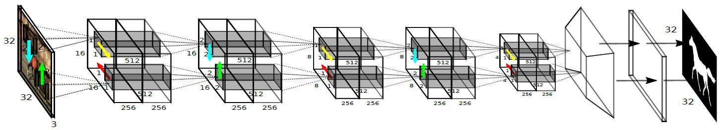
ReSeg ^{(1/2)}
ReSeg: A Recurrent Neural Network-based Model for Semantic Segmentation
The ReSeg network.
(※ The input to ReSeg is preprocessed by the pretrained VGG-16 convolutional layer, although the layer is shown here.)
The first 2 RNNs (blue and green) are applied on 2x2x3 patches of the image, their 16x16x256 feature maps are concatenated and fed as input to the next two RNNs (red and yellow) which read 1x1x512 patches and emit the output of the first ReNet layer.
Two similar ReNet layers are stacked, followed by an upsampling layer and a softmax nonlinearity.

Slide 54
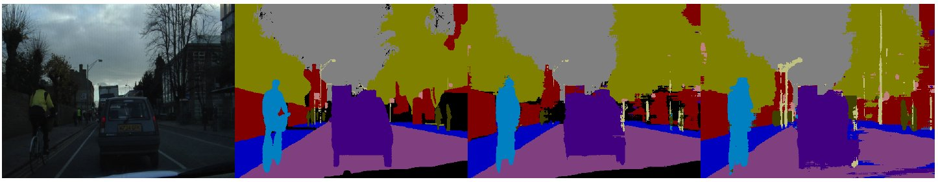
ReSeg ^{(2/2)}
ReSeg: A Recurrent Neural Network-based Model for Semantic Segmentation
Input image
Ground truth
ReSeg
ReSeg
(with class balancing)

Slide 55
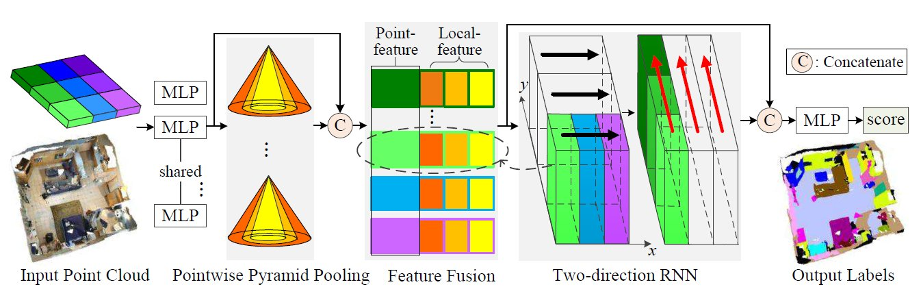
3D RNN ^{(1/4)}
3D Recurrent Neural Networks with Context Fusion for Point Cloud Semantic Segmentation
Overview of the proposed approach
The architecture takes as input the unstructured point cloud and outputs pointwise semantic labels.
Point-features and local cell features are concatenated and passed through the two-direction RNN
module along x and y.
The output of the first RNNs (black arrowed) are reorganized and fed to the next RNNs (red).

Slide 56
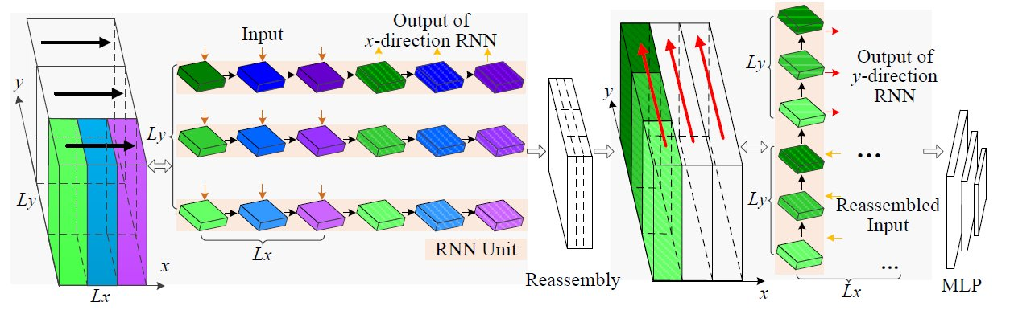
3D RNN ^{(2/4)}
3D Recurrent Neural Networks with Context Fusion for Point Cloud Semantic Segmentation
Overview of the proposed approach
The architecture takes as input the unstructured point cloud and outputs pointwise semantic labels.
Point-features and local cell features are concatenated and passed through the two-direction RNN
module along x and y.
The output of the first RNNs (black arrowed) are reorganized and fed to the next RNNs (red).

Slide 57
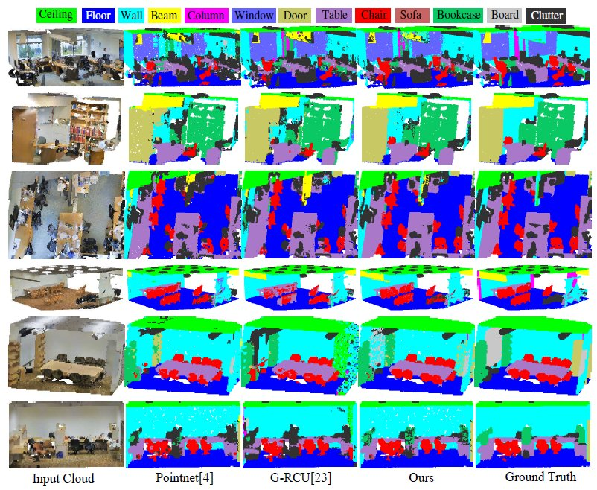
3D RNN ^{(3/4)}
Results on indoor S3DIS dataset

Slide 58
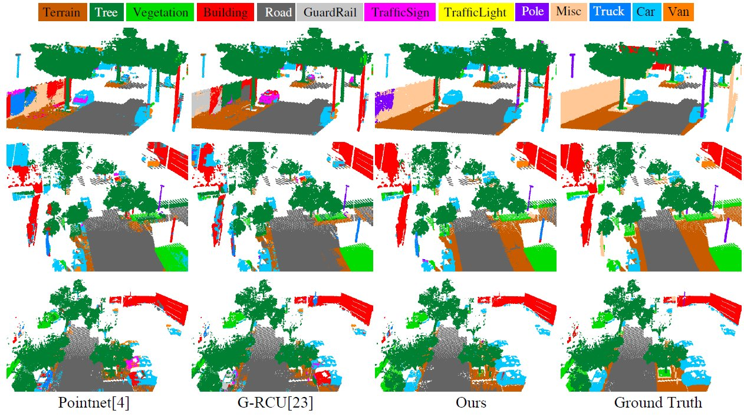
3D RNN ^{(4/4)}
Results on outdoor virtual KITTI dataset

Slide 59
Future Plan (for Point Segmentation)
Dec 2018 | ● Understanding dataset & visualize it Optech: Mobile Lynx Data (Sept 2018), Titan and Galaxy (Oct 2018) Public: Semantic3D, S3DIS, KITTI ● Practicing deep library (without the use of GPU) ● Literature review
Jan 2019 | ● Applying an existing network (e.g. PointNet) to the Optech dataset ● Literature review
▪ Also needs for a plan for noise filtering, object detection
▪ Jungwon's workstation will be fully used by at least Dec 11 (for other project).

